Slide 1

Airline Finances
Using Time series Analysis
By
Pranay Manikanta Narava
Notes:
Hello, Today I am going to present you the topic on Airline Finances using Time Series analysis

Slide 2

Introduction
Global commerce depends on aviation since it offers the only reliable global transportation system. It fosters job creation, economic expansion, and eases trade and tourism .Therefore, it becomes a complex task for Airline industry to handle finance.
Time series data is a sequence of data points collected over time intervals, allowing us to track how something changes over milliseconds, days, or even years. This feature-rich data does not simply include time as an aspect, but as a primary component of the data that helps developers analyze data and gather meaningful insights.
Notes:
To begin with, we collected the data from U S airline from Major hubs in United states, as u guys know Global commerce depends on aviation since it offers the only reliable global transportation system.Therefore, it becomes a complex task for Airline industry to handle finance. So we are applying the time series model on to Airliner revenue and netincome data to Forecast there Revenue. With this project Airline industries make there business decisions accordingly

Slide 3
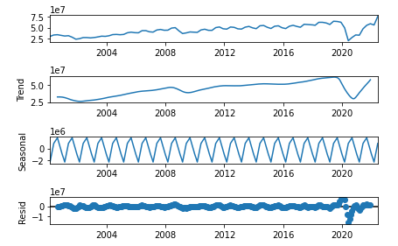
Time Series Components
Trend
Seasonal Variation
Cyclic variation
Random or Irregular Movements
Notes:
Before Applying the Time series Models to data first we need to check the weather the data is stationary or not
The Time series components are Trend , Seasonal Variation, Cyclic variation, Random or Irregular Movements
In the first graph, we can see the behavior of the raw data. Overall, it has a upward trend despite a drop at the end of the first quarter of 2020.
The second plot exhibits the trend of the data. Trend shows the overall movement of a time series. We can say that there exist a trend if there is a long-term increase or decrease in the data.
Seasonality is the third plot which shows periodical ups and downs in the data. If there is a seasonality in the data, it should also be removed. Seasonality might be weekly, monthly, quarterly, or yearly.
The last graph show the residuals. This is obtained after removing the trend and seasonal components from the time series.
Another time series component, which is not on the graph is cyclicality. It exists when higher periodic variation than the trend emerges.
And another time series component Random or Irregular Movements:
There is another kind of movement that can be seen in the case of time series. It is pure Irregular and Random Movement. As the name suggests,

Slide 4
Stationarity
What Is Stationarity ?
Stationarity is a way to model the dependent Variables that we have in time-dependent data
Why Stationarity of Data is Important?
This stationarity is having a huge influence on how data is perceived or predicted.
How to check weather the data is Stationary or not ?
By Statistical Tests:
ADF
ACF
PACF
If Data is not stationary, then how to make data Stationary?
Differencing
Notes:
What Is Stationarity ?
Stationarity is one of the most important concepts in the Time series. Stationarity is a way to model the dependent that we have in time-dependent data
Why Stationarity of Data is Important?
This stationarity is having a huge influence on how data is perceived or predicted. For data to be stationary the statistics of the data (Like the mean, variance, and autocorrelation) of the system do not change over time. but It does not mean that the series does not change over time, just that the way it changes does not itself change over time.
Stationarity is important because many useful analytical tools and statistical tests and models rely on it.
How to check weather the data is Stationary or not ?
There are Few of Statistical Test that can help us to determine weather the data is Stationary or not In these Tests, ADF Test is the Most commonly used test to find weather the data is Stationary. These test results is very easy to intercept by simply focusing on the P-value of the data. If the P-value < 0.05 then we can say our data is stationary.
If Data is not stationary, then how to make data Stationary?
The Most Commonly used method to make the Data Stationary is by Applying Differencing to the data. which helps to stabilize the mean and variance of the data by removing changes in the level of time series, by eliminating trend.

Slide 5
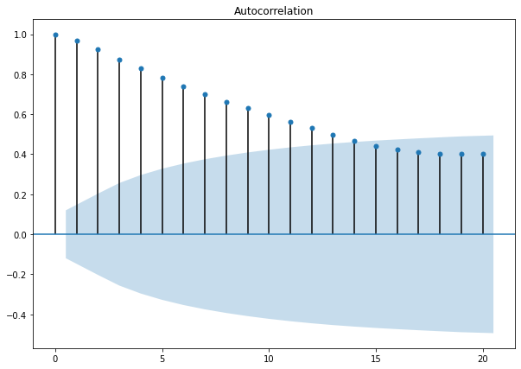
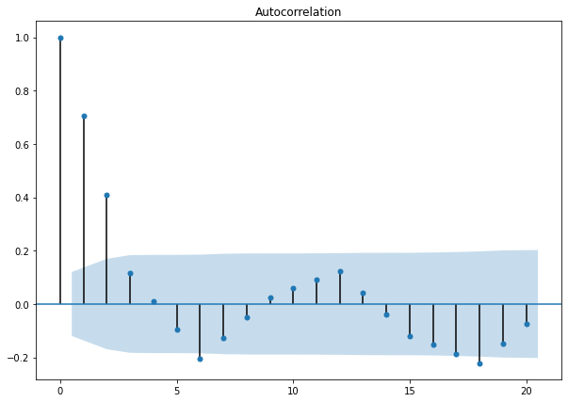
ACF (Auto Correlation Function)
ACF plot Before Differencing
Autocorrelation implies that the series is dependent this occurs when a time series is highly correlated with the lagged version the longer the bars in the ACF plot the more dependent the series.
ACF plot After Differencing
Notes:
Coming to the next part before modeling the data we need to perform the ACF and PACF test in order to Find the Parameter of the Models
Autocorrelation implies that the series is dependent this occurs when a time series is highly correlated with the lagged version the longer the bars in the ACF plot the more dependent the series.
As u can see the the 1st graph the lags from outside shaded region slowly decaing into shaded region which suggest that your data is not stationary after differencing we can see how datra is changed but still few lags outside the shaded region thses lags will be considered as parameter in the time series model

Slide 6
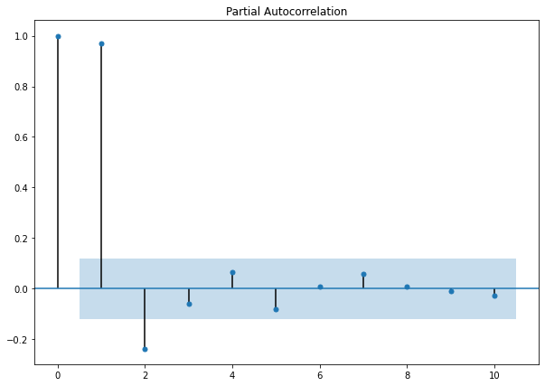
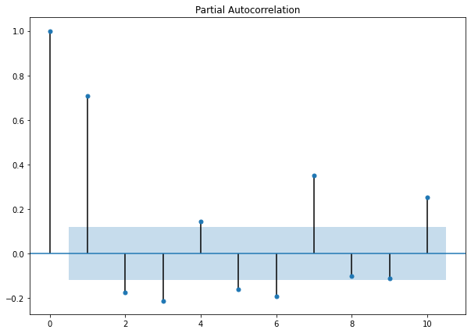
PACF (Partial Auto correlation Function)
In Time series Analysis, the partial autocorrelation function (PACF) gives the Partial correlation of a stationary time series with its own lagged values, regressed the values of the time series at all shorter lags. It contrasts with the ACF, which does not control for other lags.
PACF plot After Differencing
PACF plot Before Differencing
Notes:
In time series analysis, the partial autocorrelation function (PACF) gives the partial correlation of a stationary time series with its own lagged values, regressed the values of the time series at all shorter lags. It contrasts with the autocorrelation function, which does not control for other lags.
ACF test is best method for Moving Average. However, this ACF test does not work well with the Auto regression model for this model we use the PACF test to determine the relationship between the current value of it time series and the lagged values controlling for other correlations.

Slide 7
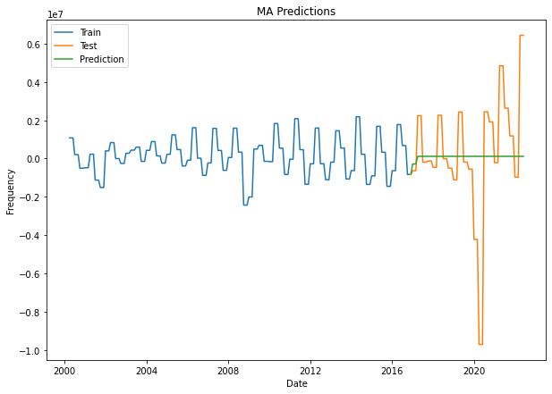
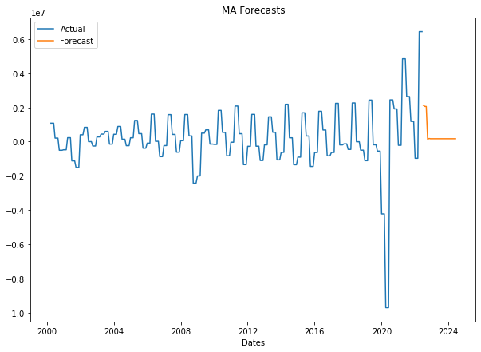
Moving Average(MA)
It is a time series model that accounts for very short-run autocorrelation.
Moving Averages, we rely on the Autocorrelation Function or ACF in short
Moving Average (MA) model
X_{t} = c + θ₁ ϵ_{t-1} + ϵ_{t}
MA Prediction Plot
MA Forecasting Plot
Notes:
After making data stationary now, we will use time series model to predict revenue.
MA
This is one of the basic statistical models that is a building block of more complex models such as the ARMA, ARIMA, SARIMA models and then we will analyze prediction and forecasting of each model and then will decide which will perform better.
The moving average model (MA) is a regression model based on past forecasting errors
Moving Averages, we rely on the Autocorrelation Function or ACF in short
We have trained 75% data and tested 25%.
From that, we got as we can see in the above graph the prediction is flat and it doesn’t make good prediction. Coming to forecasting, it deviated from the previous data, and we cannot decide whether its true or not. So there is no point of using MA for our prediction for our data.

Slide 8
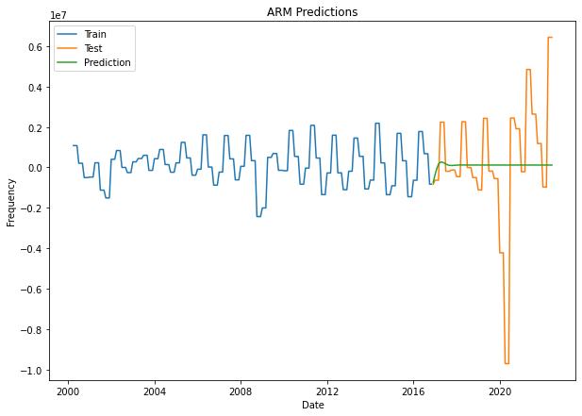
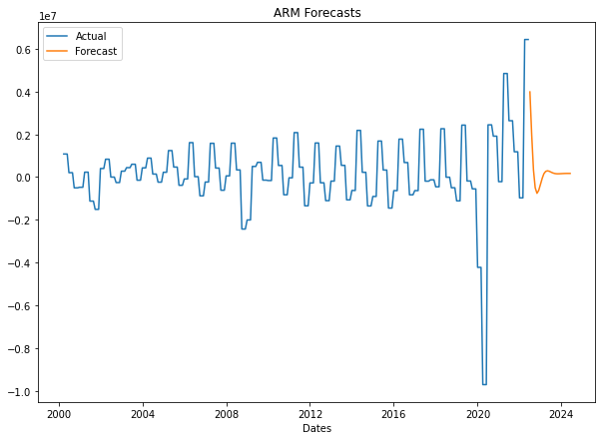
Autoregressive Model(AR)
Autoregressive model we relied on the Partial Autocorrelation Function
Using this model, the autocorrelation function may be used to determine whether there is a lack of randomness and is capable of forecasting recurring patterns in data
Autoregressive Model (MA) model
X_{t} = C + ϕ₁X_{t-1} + ϵ_{t}
Notes:
Autoregressive model we relied on the Partial Autocorrelation Function
Using this model, the autocorrelation function may be used to determine whether there is a lack of randomness and is capable of forecasting recurring patterns in data
The order, p, of the autoregressive model can be determined by looking at the partial autocorrelation function (PACF)
Compared to the above-moving average, At starting it showed a slight match with test data but it became flat and still not accurate and also it showed slight improvement in forecasting but still we cannot trust this.
Now lets see ARMA model performs

Slide 9
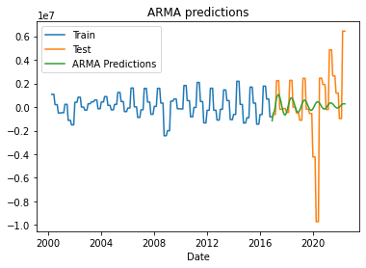
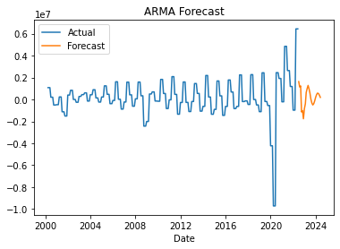

ARMA (Auto Regressive Moving Average)
It is the combination of Autoregressive (AR) and Moving Average (MA) models
The ARMA model predicts the future values based on both the previous values and errors
Autoregressive Moving Average (ARMA) model 𝑋𝑡=𝛼+𝛽1𝑋𝑡−1+𝛽2𝜖𝑡−1+𝜖𝑡
Notes:
ARMA
Autoregressive Moving Average is known by the abbreviation ARMA.
The Autoregressive (AR) and Moving Average (MA) models, two less complex models, were combined to create ARMA
The ARMA model predicts the future values based on both the previous values and errors
From this above graphs , its clear that it is performing better than MA but the predictions graphs is not exactly coinciding with test graph , thus we cannot trust forecasting graph too

Slide 10
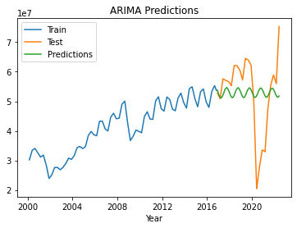
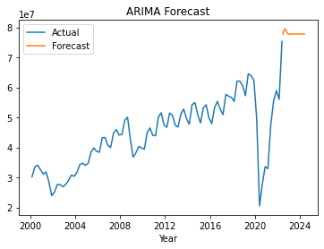
ARIMA (Auto Regressive Integrative Moving Average) order = (p, d, q))
An ARIMA(Autoregressive integrated moving average model) is a form of regression analysis that gauges the strength of one dependent variable relative to other changing variables. The model's goal is to predict future securities or financial market moves by examining the differences between values in the series instead of through actual values.
ARIMA(p, d, q) has three parameters. The ‘p’ and ‘q’ parameters of ARIMA come from AR and MA components, respectively the ‘d’ parameter represents the order of difference.
𝑋𝑡=𝛼+𝛽1𝑋𝑡−1+𝛽2𝜖𝑡−1+𝜖𝑡
𝑍𝑡=𝑋𝑡+1−𝑋𝑡
Notes:
Regression analysis that measures the strength of one dependent variable in relation to multiple fluctuating variables is known as an autoregressive integrated moving average model. Instead of using actual values, the model looks at variations between values in the series to forecast future securities or financial market movements.
In a nutshell, ARIMA(p,d,q) has three parameters and one of is for making a series stationary. The first and third parameters of ARIMA come from AR and MA components, respectively and as we can guess the second parameter represents the order of difference.
P : lag order, or the number of lag data in the model•
d : the number of differences applied to the original observations; often called the degree of differencing.•
q : the order of the moving average; usually referred to as the moving average window size.
GRAPH : We can see that ARIMA performed a bit better compared to previously explained models. But still, it’s not perfect as you can see that the prediction graph is not exactly coinciding with the Test data graph therefore, we cannot trust the forecasting of ARIMA. Now, lets try SARIMA and see how this model performs.

Slide 11
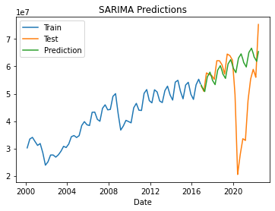
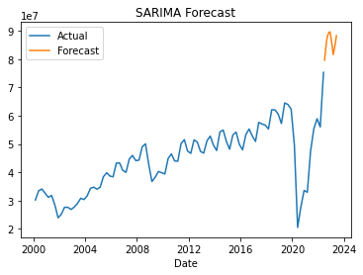
SARIMA (Seasonal-ARIMA) order=(p, d, q), seasonal order = (P, D, Q)_{m})
SARIMA, which stands for Seasonal-ARIMA, contains the forecast's seasonality component.
The model's remaining components are still the ARIMA's moving average (MA), integrated (I), and autoregressive (AR) components. The SARIMA model is made more robust by the inclusion of seasonality
Similar to ARIMA, the P,D,Q values for seasonal parts of the model can be deduced from the ACF and PACF plots of the data
p, d , q
P, D, Q
m
Non-seasonal
seasonal
Notes:
SARIMA, which stands for Seasonal-ARIMA, contains the forecast's seasonality component. The significance of seasonality is pretty obvious, yet ARIMA fails to implicitly capture that information.
GRAPH As you can see, it quickly learned the right path. However, in 2020 the model struggled to fit probably because of unpredictable COVID pandemic. The fit is quite good as compared to the ARIMA one suggesting that SARIMA can learn seasonality better and if it’s present in the data then it’d make sense to try SARIMA out.

Slide 12
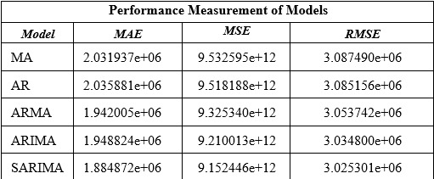
Performance Check
MAE : Evaluates the absolute distance of the observations (the entries of the dataset) to the predictions on a regression, taking the average over all observations. We use the absolute value of the distances so that negative errors are accounted properly.
MSE : Another way to do so is by squaring the distance, so that the results are positive. This is done by the MSE, and higher errors (or distances) weigh more in the metric than lower ones, due to the nature of the power function.
RMSE: backlash in MSE is the fact that the unit of the metric is also squared, so if the model tries to predict price in US$, the MSE will yield a number with unit (US$)² which does not make sense. RMSE is used then to return the MSE error to the original unit by taking the square root of it, while maintaining the property of penalizing higher errors.
Notes:
Coming to performance check we used Three most commonly used test which are MAE, MSE, RMSE
So when it comes to MAE (Mean Average Error)
This is a commonly used performance evaluation metric in regression models. In words, absolute error is the absolute value of the difference between the predictions value and the actual observations.
MSE(Mean Square Error)
Similar to MAE, MSE tells us the extent to which predictions deviates from actual values. But the way it is calculated is a bit different from MAE. MSE is calculated by taking the differences between predictions and actual values and square them. The squaring is necessary to remove any negative signs. It also gives more weight to larger differences.
RMSE is Root of MSE
From this table we can observe that Sarima modle having the Least MAE & MSE value which stats that SARIMA is more Accurte to predict the model compared to others

Slide 13
Conclusion
With the Help of Time series model, we able to predict and forecast the Revenue of Major US airline which operated from Major US Hubs
We Applied Five Univariate Time Series Models on the Data
With the Help of Statistical Test, we able to determine that SARIMA model more precise at Predicting and forecasting the trend more than the remaining models due to Seasonality.
From this project, Time series models SARIMA is helping in identifying future revenue with better accuracy.
So, this will be helping airline industries in taking better decisions. Thus, helps to improve overall revenue.
Notes:
With the Help of Time series model, we able to predict and forecast the Revenue of US airline
We Applied Five Univariate Time Series Models on the Data
With the Help of Statistical Test, we able to determine that SARIMA model is more precise at Predicting and forecasting the trend more than the remaining models due to Seasonality.
From this project, Time series models are helping in identifying future revenue with better accuracy.
So, this will be helping airline industries to improve overall revenue.
We even developed a stream lit web application, we designed it in a way where it can take both revenue or any time series data to forecast the data.

Slide 14

References
Bondoux, N., Nguyen, A.Q., Fiig, T. et al. Reinforcement learning applied to airline revenue management. 19, 332–348 (2020).
Time Series Prediction: How Is It Different From Other Machine Learning?
Konda Hi makireeti and Tammishetti Vishnu, Air Passengers Occupancy Prediction Using Arima Model V14 (2019) pp. 646-650
Mehandzhiyski, V. (2021, October 20). Retrieved from https://365datascience.com/tutorials/time-series-analysis-tutorials/arma-model/
HAYES,A.(2021,October12).Retrieved from https://www.investopedia.com/terms/a/autoregressive-integrated-moving-average-arima.
SARIMA Using Python – Forecast Seasonal Data https://www.wisdomgeek.com/development/machine-learning/sarima-forecast-seasonal-data-using-python/
Efficient Time-Series Analysis Using Python’s Pmdarima Library https://towardsdatascience.com/efficient-time-series-using-pythons-pmdarima-library-f6825407b7f0
Time Series Forecasting with ARIMA , SARIMA and SARIMAX https://towardsdatascience.com/time-series-forecasting-with-arima-sarima-and-sarimax-ee61099e78f6
Dr. Saul McLeod .What a p-value tells you about statistical significance https://www.simplypsychology.org/p-value.html

